Slide 1
Artificial Intelligence and Machine Learning Basics

Slide 2
Artificial Intelligence / Machine Learning
Quote from Quora: Quora’s mission is to share and grow the world’s knowledge. A vast amount of the knowledge that would be valuable to many people is currently only available to a few — either locked in people’s heads, or only accessible to select groups.
https://www.quora.com/What-are-the-main-differences-between-artificial-intelligence-and-machine-learning-Is-machine-learning-a-part-of-artificial-intelligence

Slide 3
What is Artificial Intelligence(AI)? (Quora)
a technique that enables the machines to act like humans by replicating their behavior and nature.
With AI it is possible for machines to learn from their experience.
The machines adjust their response based on new inputs thereby performing human-like tasks.
Artificial Intelligence can be trained to accomplish specific tasks by processing large amounts of data and recognizing patterns in them.

Slide 4
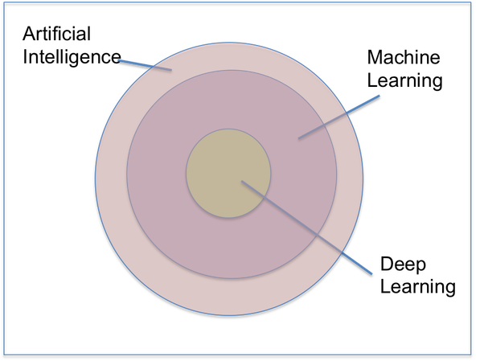
What is Machine Learning? (Quora)
a subset of AI
which enables the computer to act and make data-driven decisions to carry out a certain task.
These programs or algorithms are designed in a way that they can learn and improve over time when exposed to new data

Slide 5
What is Deep Learning? (Quora)
You can consider
deep learning models as a rocket engine
and its fuel as the huge amount of data that we feed to these algorithms.
This field is a particular kind of machine learning that is inspired by the functionality of our brain cells called artificial neural network
The difference between machine learning and deep learning is to know that deep learning is machine learning. More specifically, it’s the next evolution of machine learning.

Slide 6

What is Machine Learning ?
Using known data, develop a model to predict unknown data.
Notes:
Basic definition:
Machine learning develops algorithms for making predictions (statistical sense) from data *
Learning models from available training data, to make good predictions on unseen test data

Slide 7
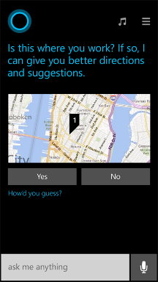
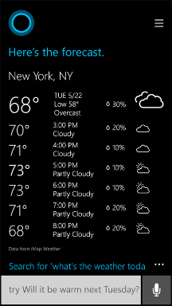
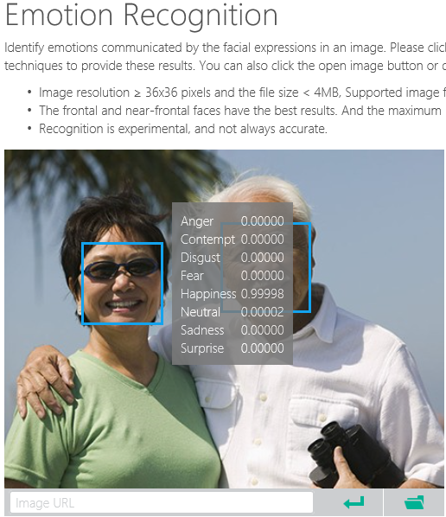
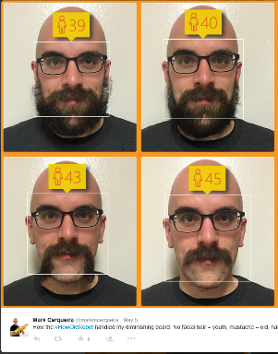
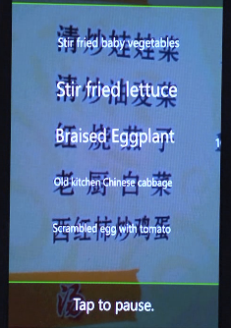
Why Machine Learning?
Notes:
Smart applications, services, platforms…
Digital Smart Personal Assistant
Image / Text / Data analyze

Slide 8
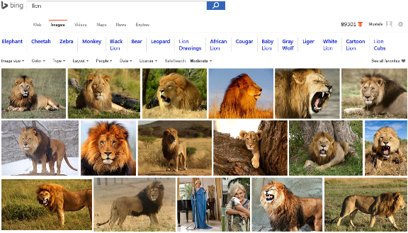
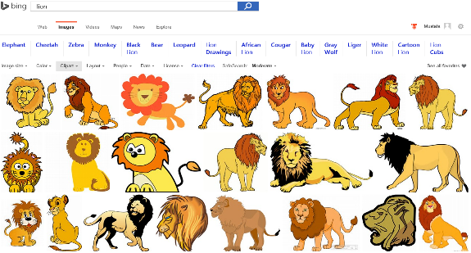
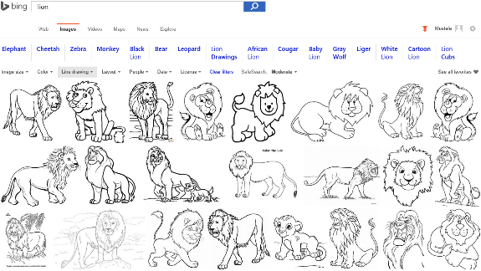
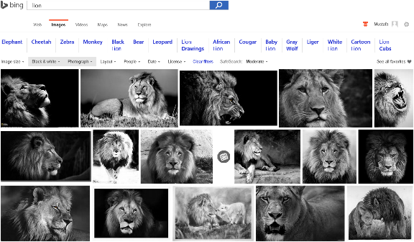
Image Analyze
Notes:
Search “lions” on Bing and change Image type etc. filters…
Behind the ML service categorizes the image db and returns the result.

Slide 9
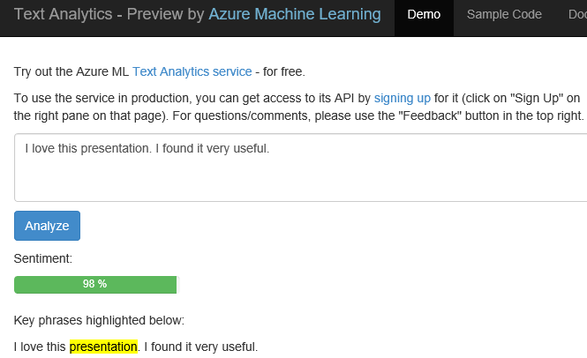
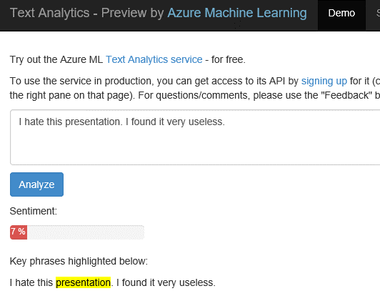
Text Analytics: User reviews
Positive
Negative
Notes:
Ready to use ML API published on Azure Datamarket place. A showcase of production ML solution in action (This can be used i.e. in shopping websites to see user reviews about a product etc.)
Test by yourself some of the reviews comments on Expedia or other online shopping sites. Copy/paste user comments to see the analyze result. If sentiment result shows higher percentage number, it means it is positive. If the percentage is low than it is a negative comment.
https://text-analytics-demo.azurewebsites.net/

Slide 10

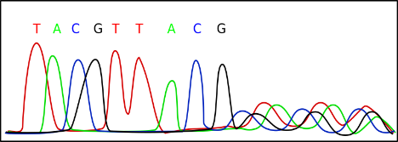
Data Science
Data Science is far too complex
Cost of accessing/using efficient ML algorithms is high
Comprehensive knowledge required on different tools/platforms to develop a complete ML project
Difficult to put the developed solution into a scalable production stage
Need a simpler/scalable method:
Azure Machine Learning Service
Notes:
Actually it is the science on data

Slide 11

Microsoft Azure Machine Learning
Make machine learning accessible to every enterprise, data scientist, developer, information worker, consumer, and device anywhere in the world.

Slide 12
From data to decisions and actions
Data
Recommendations
What should I do?
Decision
Action
Decision automation
Decision support
Predictions
What will happen?
Interactive dashboards
Why did it happen?
Static reports
What happened?
Manual process
Value
Notes:
Azure ML aims to transform your data in to an intelligent action

Slide 13






Transform data into intelligent action
Information Management
Big Data Stores
Machine Learning and Analytics
Dashboards and Visualizations
Business apps
Power BI
Azure
Data Factory
Azure
Machine Learning
Personal Digital Assistant
Azure
Data Lake
Cortana
People
Custom apps
Azure
Data Catalog
Azure
HDInsight (Hadoop)
Perceptual Intelligence
Azure
SQL Data Warehouse
Face, vision
Speech, text
Azure
Event Hub
Azure
Stream Analytics
Business Scenarios
Sensors and devices
Recommendations,
customer churn,
forecasting, etc.
Automated Systems
DATA
INTELLIGENCE
ACTION

Slide 14
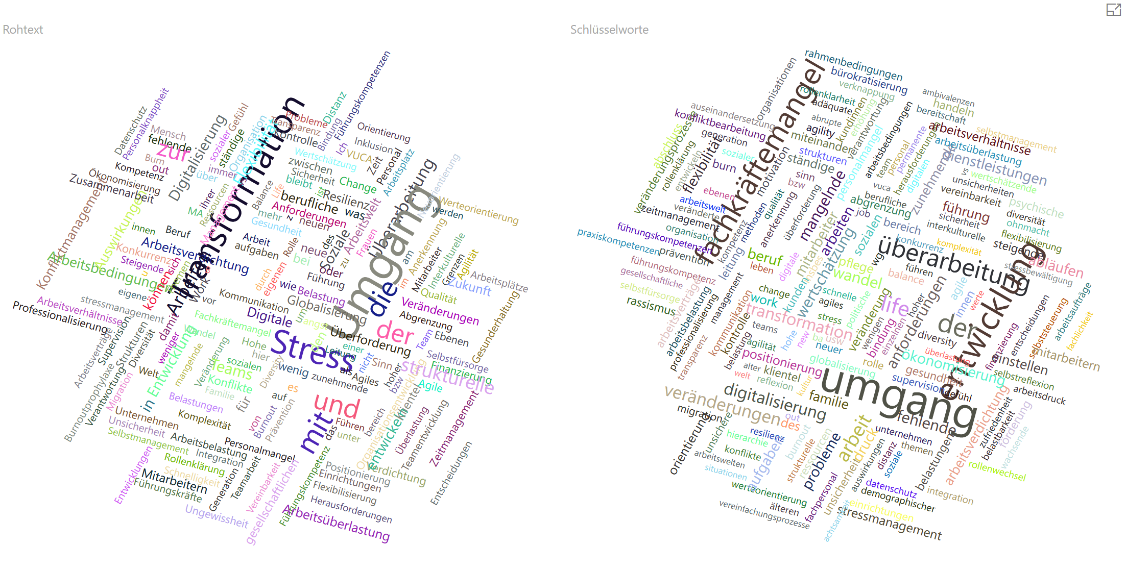
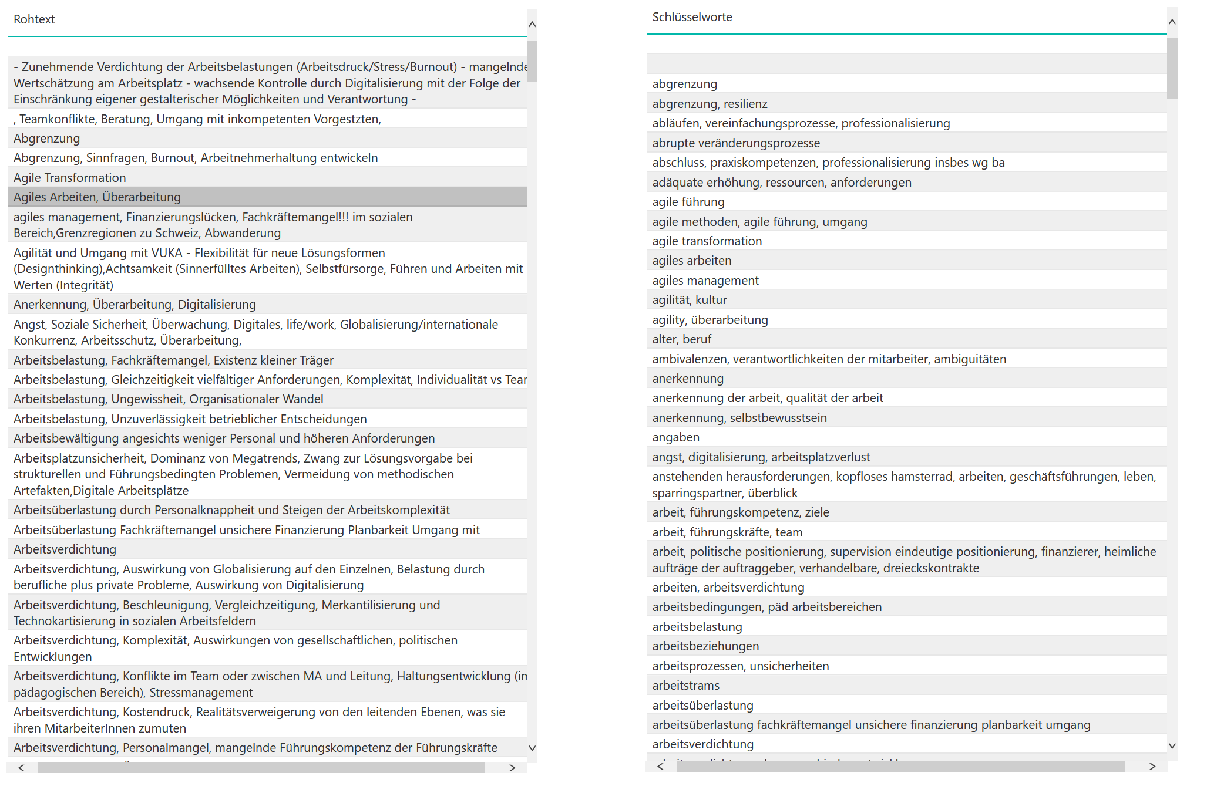
Simple Example for extracting Key Phrases

Slide 15
Simple Example for extracting Key Phrases
Survey with multiple-choice answers and text-answers in german language
Text-Answers of the survey were entered into a web-form
Text-Answers had to be analyzed for each question
Cognitive Services were used to extract key phrases
Microsoft Power BI was used to present results

Slide 16
Simple Example for extracting Key Phrases
Extract key phrases of answers entered into a web form during a survey for german coaches
https://app.powerbi.com/view?r=eyJrIjoiYzE4ZjBiYTQtZjBkNy00YWMzLWFjYTYtN2IzMGYzOGIyZWRkIiwidCI6Ijg4OGZhYjhhLTdiZjAtNGY2Yi04MGY0LTk1ZGFiYzU0MzM4NyIsImMiOjh9
Based on the following tutorial using Azure Cognitive Services:
https://docs.microsoft.com/de-de/azure/cognitive-services/text-analytics/tutorials/tutorial-power-bi-key-phrases

Slide 17
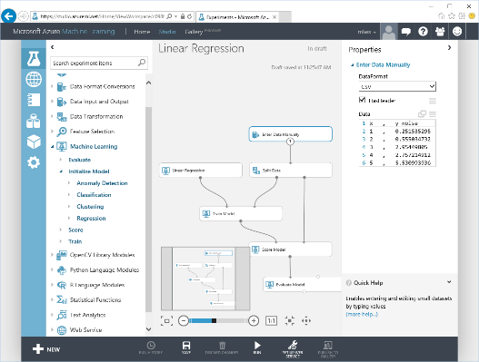
Microsoft Azure Machine Learning
Web based UI accessible from different browsers
Share|collaborate to any other ML workspace
Drag&Drop visual design|development
Wide range of ML Algorithms catalog
Extend with OSS R|Python scripts
Share|Document with IPython|Jupyter
Deploy|Publish|Scale rapidly (APIs)
Notes:
Lets look at some of the features of ML Studio

Slide 18
Microsoft Azure Machine Learning
ML Algorithms
Best of MS
ML Studio
Data Scientist
ML Operationalization
IT Professional
ML APIs Marketplace
ISVs & Developers
Notes:
How customers generally benefit from Azure ML

Slide 19
Azure Machine Learning Ecosystem
Provision Workspace
Build ML Model
Deploy as Web Service
Publish an App
Get/Prepare Data
Publish Web Service
Get Azure Subscription
Create Workspace
Evaluate Model Results
Build/Edit Experiment
Azure Data
Marketplace
Create/Update Model
Notes:
Stages to develop end to end Azure ML solution. First you need an AML workspace... then you build a model under AML Studio, then publish it as web service and as an app (see text analytics demo in prior slides)

Slide 20
Azure Machine Learning Service Data -> Predictive model -> Operational web API in minutes
Data
Clients
API
ML STUDIO
Model is now a web service that is callable
Blobs and Tables
Hadoop (HDInsight)
Relational DB (Azure SQL DB)
Integrated development environment for Machine Learning
Monetize the API through our marketplace
Notes:
With the cloud, you can bring in data sources with the ease of a drop down or drop your on-premises data set into the built in storage space. Users can then model in our development environment – Machine Learning Studio – where we’re offering R, Python and SQLite as first class citizens in addition to our world-class Microsoft algorithms.
The second issue – and often the primary one – is putting finished work into production in a way others can use. We’ve heard from many data scientists that they model in R on a Linux stack but then have to hand over their work to developers who need to translate that into another language to actually make it work. This time consuming and unnecessary process has been eliminated with our system, as the model is with a click transformed into a web service end-point that can run over any data, anywhere and connect to any solution or client.
Next, not only can this model be put into production for your company, it can be made available for the world on our Machine Learning Marketplace. Microsoft hosts your solution and markets it for you, while you have the freedom to brand and monetize as you see fit. We also offer a number of Microsoft solutions here.

Slide 21
What is Machine Learning ?
Using known data, develop a model to predict unknown data.
Known Data: Big enough archive, previous observations, past data
Unknown Data: Missing, Unseen, not existing, future data
Model: Known data + Algorithms (ML algorithms)
Notes:
Basic definition:
Machine learning develops algorithms for making predictions (statistical sense) from data *
Learning models from available training data, to make good predictions on unseen test data
Highlight the keywords: Known Data, Model, Unknown Data and the Prediction (statistically…)

Slide 22
Azure Machine Learning Service Data -> Predictive model -> Operational web API in minutes
Data
Clients
API
ML STUDIO
Model is now a web service that is callable
Blobs and Tables
Hadoop (HDInsight)
Relational DB (Azure SQL DB)
Integrated development environment for Machine Learning
Monetize the API through our marketplace
Notes:
With the cloud, you can bring in data sources with the ease of a drop down or drop your on-premises data set into the built in storage space. Users can then model in our development environment – Machine Learning Studio – where we’re offering R, Python and SQLite as first class citizens in addition to our world-class Microsoft algorithms.
The second issue – and often the primary one – is putting finished work into production in a way others can use. We’ve heard from many data scientists that they model in R on a Linux stack but then have to hand over their work to developers who need to translate that into another language to actually make it work. This time consuming and unnecessary process has been eliminated with our system, as the model is with a click transformed into a web service end-point that can run over any data, anywhere and connect to any solution or client.
Next, not only can this model be put into production for your company, it can be made available for the world on our Machine Learning Marketplace. Microsoft hosts your solution and markets it for you, while you have the freedom to brand and monetize as you see fit. We also offer a number of Microsoft solutions here.

Slide 23
AI and ML Basics
3 general Tasks in Machine Learning:
Classification
Regression
Clustering

Slide 24




Model (Regression)
90°F
1990
50°F
30°F
68°F
95°F
Predict 2020 Summer
2000
48°F
29°F
70°F
98°F
2010
49°F
27°F
67°F
96°F
-26°F
Using known data, develop a model to predict unknown data.
Notes:
Using appropriate algorithms with the existing data, we generate a mathematical model, formulation or define a pattern to predict future, unknown values
Highlight the keywords: Known Data, Model, Unknown Data and the Prediction (statistically…)

Slide 25
Model (Decision Tree)
Age<30
Income > $50K
Xbox-One Customer
Not Xbox-One Customer
Days Played > 728
Income > $50K
Xbox-One Customer
Not Xbox-One Customer
Xbox-One Customer
Notes:
More samples on: https://azure.microsoft.com/en-us/documentation/articles/machine-learning-algorithm-choice/

Slide 26

Model (Classification)
Classify a news article as (politics, sports, technology, health, …)
Politics
Sports
Tech
Health
Using known data, develop a model to predict unknown data.

Slide 27
Known data (Training data)
Documents
Labels
Tech
Health
Documents consist of unstructured text. Machine learning typically assumes a more structured format of examples
Politics
Politics
Process the raw data
Sports
Using known data, develop a model to predict unknown data.

Slide 28
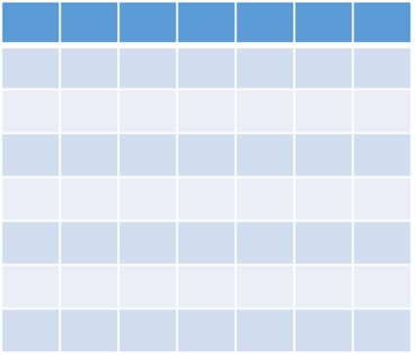
Feature vector
i.e.
Blood Pressure
Age
Height/Weight
Hearth Rate
{40, (180, 82), (11,7), 70, …..} : Healthy
Known data
Features
Label
Data instance
Feature Vector
Notes:
Just a brief info about some keywords used in ML

Slide 29




Developing a Model
Training data
Base Model
Documents
Labels
Feature Vectors
Tech
Adjust
Parameters
Health
Politics
Train the Model
Politics
Sports
Using known data, develop a model to predict unknown data.

Slide 30


Model’s Performance
True
labels
Predicted
labels
Detach
Model’s
Performance
Difference between “True Labels” and “Predicted Labels”
+/-
Known data with true labels
Tech
+/-
Tech
Health
Health
Politics
Politics
Politics
Politics
Tech
Health
Test data 20%
+/-
Sports
Sports
Politics
Politics
Split
Compare prediction
with true labels
Test trained model with features
Training data 80%
Tech
Health
Politics
Train the Model
Sports
Politics
Sports
Notes:
Ratio of the Test/Training data is trivial. Depends on model, data size, quality etc.
Split is random (i.e. which %80 portion of the data?)
There is no rule to split into %80 & %20 … it might be %50 & %50 etc depending on the problem, model, case.
If you are not happy with the Model’s performance than adjust the parameters and re-train the model. Or change the algorithm (training approach) behind the method…

Slide 31
Steps to Build a Machine Learning Solution
1
Problem Framing
2 Get/Prepare Data
3
Develop Model
4
Deploy Model
5
Evaluate / Track Performance
3.1
Analysis/ Metric definition
3.2
Feature Engineering
3.3
Model Training
3.4
Parameter Tuning
3.5
Evaluation

Slide 32

Example use cases
Finance and risk
Sales and marketing
Customer and channel
Operations and workforce
Revenue Forecasting
Sales forecasting
User segmentation
Agent allocation
$$$
Portfolio optimization
Demand forecasting
Personalized offers
Warehouse efficiency
Investment modelling
Sales lead scoring
Product recommendation
Smart buildings
$$$
Fraud detection
Marketing mix optimization
Predictive maintenance
Risk management
Supply chain optimization
Notes:
Confidential…
+ notes From the book: AzureMachineLearning – AzureFundamentals
Many examples of predictive analytics can be found literally everywhere today in our society:
Spam/junk email filters These are based on the content, headers, origins, and even user behaviors (for example, always delete emails from this sender).
Mortgage applications Typically, your mortgage loan and credit worthiness is determined by advanced predictive analytic algorithm engines.
Various forms of pattern recognition These include optical character recognition (OCR) for routing your daily postal mail, speech recognition on your smart phone, and even facial recognition for advanced security systems.
Life insurance Examples include calculating mortality rates, life expectancy, premiums, and payouts.
Medical insurance Insurers attempt to determine future medical expenses based on historical medical claims and similar patient backgrounds.
Liability/property insurance Companies can analyze coverage risks for automobile and home owners based on demographics.
Credit card fraud detection This process is based on usage and activity patterns. In the past year, the number of credit card transactions has topped 1 billion. The popularity of contactless payments via near-field communications (NFC) has also increased dramatically over the past year due to smart phone integration.
Airline flights Airlines calculate fees, schedules, and revenues based on prior air travel patterns and flight data.
Web search page results Predictive analytics help determine which ads, recommendations, and display sequences to render on the page.
Predictive maintenance This is used with almost everything we can monitor: planes, trains, elevators, cars, and yes, even data centers.
Health care Predictive analytics are in widespread use to help determine patient outcomes and future care based on historical data and pattern matching across similar patient data sets.

Slide 33


Machine Learning Algorithms
ML Algorithm defines how your model will react
Which Algorithm to use? Depends on:
Data Quality
Data Size
What you want to predict
Time constraint
Computation power
Memory limits

Slide 34
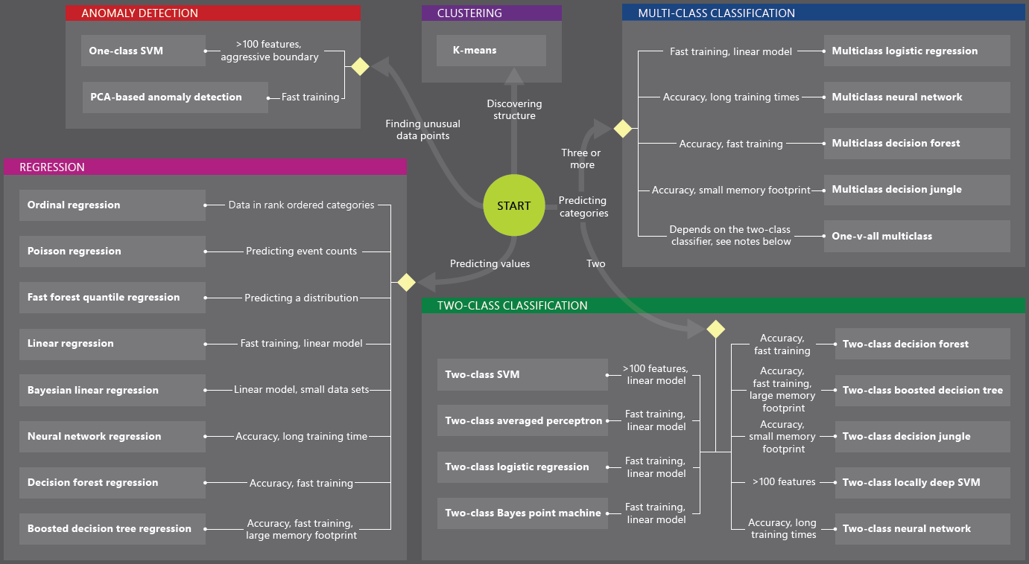
Machine Learning Algorithms
You can develop solutions by using
Custom algorithms written in R | Python
Ready to use ML services from data market
Existing algorithms

Slide 35
Machine Learning Algorithms
Two major category of algorithms
Supervised
Unsupervised
Most commonly used machine learning algorithms are supervised (requires labels)
Supervised learning examples
This customer will like coffee
This network traffic indicates a denial of service attack
Unsupervised learning examples
These customers are similar
This network traffic is unusual
Notes:
How to choose algorithms for Microsoft Azure Machine Learning
https://azure.microsoft.com/en-us/documentation/articles/machine-learning-algorithm-choice/

Slide 36
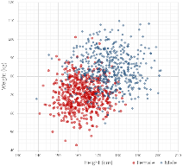
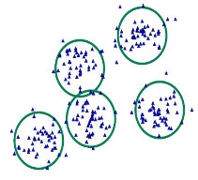
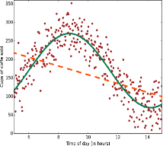
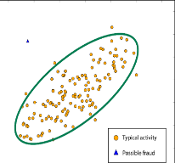
Common Classes of Algorithms (Supervised|Unsupervised)
Classification
Clustering
Regression
Anomaly Detection
Notes:
More samples on: https://azure.microsoft.com/en-us/documentation/articles/machine-learning-algorithm-choice/
Mention about Classification, Regression etc.

Slide 37
Why you need to know these algorithms?
If you want to answer a YES|NO question, it is classification
If you want to predict a numerical value, it is regression
If you want to group data into similar observations, it is clustering
If you want to recommend an item, it is recommender system
If you want to find anomalies in a group, it is anomaly detection
and many other ML algorithms for specific problem

Slide 38
Classification
Scenarios:
Which customer are more likely to buy, stay, leave (churn analysis)
Which transactions|actions are fraudulent
Which quotes are more likely to become orders
Recognition of patterns: speech, speaker, image, movement, etc.
Algorithms: Boosted Decision Tree, Decision Forest, Decision Jungle, Logistic Regression, SVM, ANN, etc.
Classification

Slide 39
Clustering
Scenarios:
Customer segmentation: divide a customer base into groups of individuals that are similar in specific ways relevant to marketing, such as age, gender, interests, spending habits, etc.
Market segmentation
Quantization of all sorts, such as, data compression, color reduction, etc.
Pattern recognition
Algorithms: K-means
Clustering

Slide 40
Regression
Scenarios:
Stock prices prediction
Sales forecasts
Premiums on insurance based on different factors
Quality control: number of complaints over time based on product specs, utilization, etc.
Workforce prediction
Workload prediction
Algorithms: Bayesian Linear, Linear Regression, Ordinal Regression, ANN, Boosted Decision Tree, Decision Forest
Regression

Slide 41
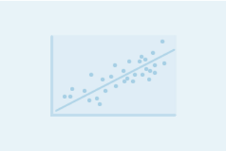
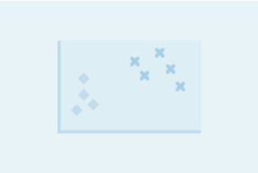
Regression versus Classification
Does your customer want to predict|estimate a number (regression) or apply a label|categorize (classification)?
Regression problems
Estimate household power consumption
Estimate customer’s income
Classification problems
Power station will|will not meet demand
Customer will respond to advertising

Slide 42
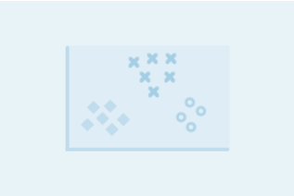
Binary versus Multiclass Classification
Does your customer want a yes|no answer?
Binary examples
click prediction
yes|no
over|under
win|loss
Multiclass examples
kind of tree
kind of network attack
type of heart disease

